Slide 1

ai in work and society
opportunities for an ‘augmented’ intelligence
Christine T. Wolf, JD, PhD
IBM Research, Almaden
ctwolf@us.ibm.com //
UBC iSchool, DL-NLP Course, Nov. 14, 2018

Slide 2
agenda
overview/background
overview of current projects
some resources…

Slide 3
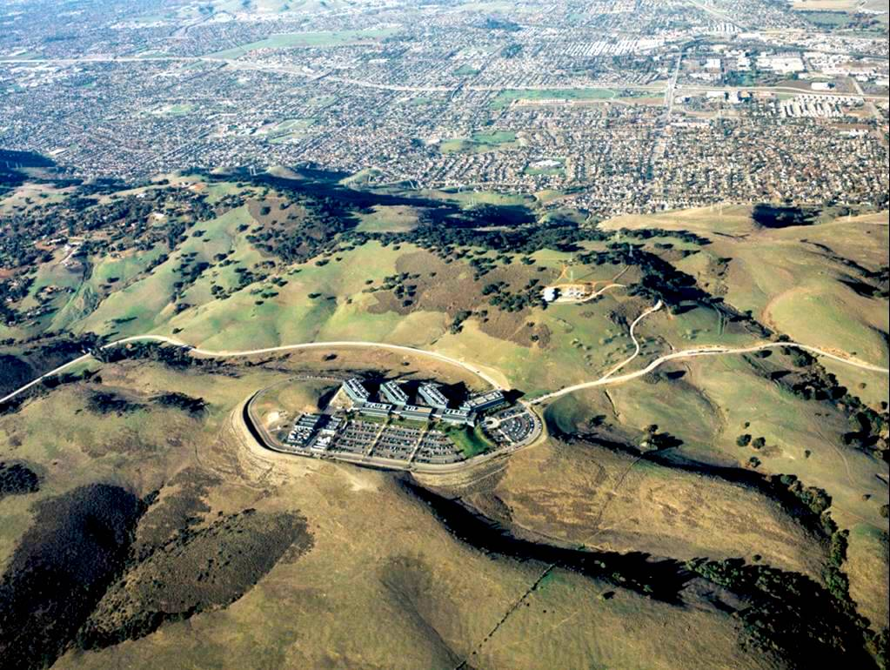
almaden

Slide 4

service orientation

Slide 5
/MAKING SENSE/
//OF COGNITIVE SYSTEMS//

Slide 6
stream one
ML dev work
stream two
agile deployment/use
/MAKING SENSE/
//OF COGNITIVE SYSTEMS//

Slide 7
stream two
agile deployment/use
/MAKING SENSE/
//OF COGNITIVE SYSTEMS//

Slide 8

case:
IT services procurement
/IT infrastructure design

Slide 9
models are good at identifying
patterns, outliers, variance
architects are good at understanding
client context and adapting to change
learning to collaborate with algorithms

Slide 10
stream one
ML dev work
/MAKING SENSE/
//OF COGNITIVE SYSTEMS//

Slide 11

focus:
ML development as everyday work practice
nonroutine – adversarial AI use case
routine – model correction practices

Slide 12
focus:
ML development as everyday work practice
documentation & transparency
promote reflection & mitigate bias

Slide 13
some resources

Slide 15

Some Resources…

Slide 16
Some Resources…

Slide 17
Some Resources…

Slide 18
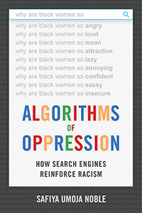



Some Resources…

Slide 19
For more information:
http://research.ibm.com
Notes:
Visit IBM Research at our website: http://research.ibm.com.
Follow us on Twitter: https://twitter.com/ibmresearch
On Facebook: https://www.facebook.com/IBMResearch
On YouTube: https://www.youtube.com/user/IBMLabs

